Slide 1
Anaplan
Go-to-market Planning Applications
Go-to-Market Capacity Planning
Technical Overview
Application Version 1.1.0
Last updated June 5, 2025

Slide 2
Confidentiality notice
This documentation and any related materials are provided solely for the use of authorized Anaplan customers who have purchased the Go-to-Market Capacity Planning Application and are considered Anaplan proprietary information. The information contained herein is intended exclusively for the purpose of implementing the application by authorized customers. Any use outside of this intended purpose is strictly prohibited, including but not limited to:
  Sharing, distributing, or disclosing this content with or to individuals or entities not directly involved in the customer’s authorized implementation.
  Using the documentation, in whole or in part, to replicate, retrofit, or reverse-engineer the functionality in other models, environments, or platforms.
This documentation contains proprietary information of Anaplan and is protected by applicable intellectual property laws.
Any unauthorized use, reproduction, or dissemination is a violation of these terms and may result in legal action.

Slide 3

Table of Contents
1
Overview
2
Process and configurable elements
3
Prework and assumptions
4
Model design

Slide 4
Overview
Section 1

Slide 5
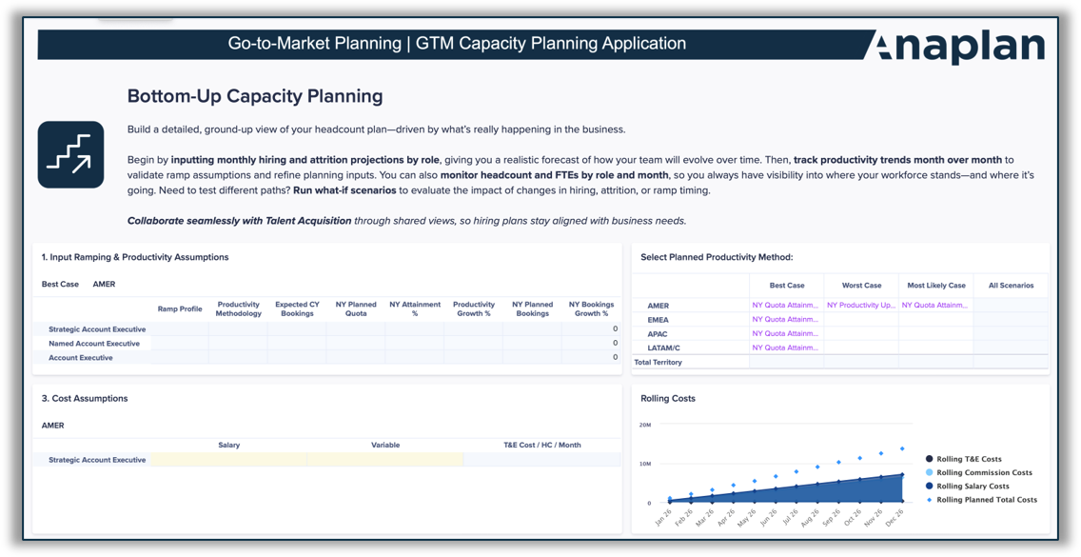
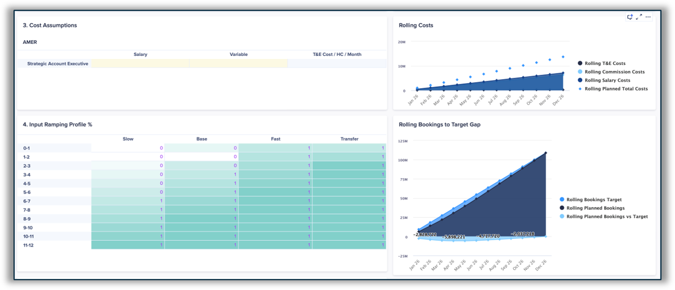
Go-to-Market Capacity Planning
Out-of-the-box functionalities to define, forecast, and analyze workforce capacity across GTM roles and hierarchies
FTE & Headcount Reporting:
  Track FTE and headcount with real-time visibility by role, hierarchy, and month across the GTM hierarchies.
  View employee-level details, role history, and model ramp assumptions.
Coverage Analysis:
  Identify HC gaps and optimize core vs. support resources.
  Define role-based and time-based coverage assumptions.
Productivity & Performance Analysis:
  Analyze and compare reps against role-based performance by configurable dimensions (e.g., segment, industry, tenure).
  Model productivity uplift.
  Top-down & Bottom-up Planning:
  Input hiring, attrition, and productivity assumptions per role.
  Track monthly headcount trends and hiring needs.
  Cascade resource allocation through the sales hierarchy.
  Apply constraints and recommendations for resource planning.
  Manage approvals and disputes in a structured workflow.
Sales Margin Planning:
  Define role-based cost structures and aggregate data.
  Track monthly sales margins based on productivity and ramping.
In-Year vs. Actual Planning:
  Lock planning inputs and snapshot hiring plans.
  Compare actual vs. planned HC and hiring needs for realignment; re-open planning period to adjust strategy.
  GTM Strategy & Blueprinting
  Model sales hierarchy changes in a sandbox.
  Maintain an approval workflow and audit trail.
  Conduct what-if scenario modeling for strategic decisions.
  Approve and export finalized headcount plans.

Slide 6
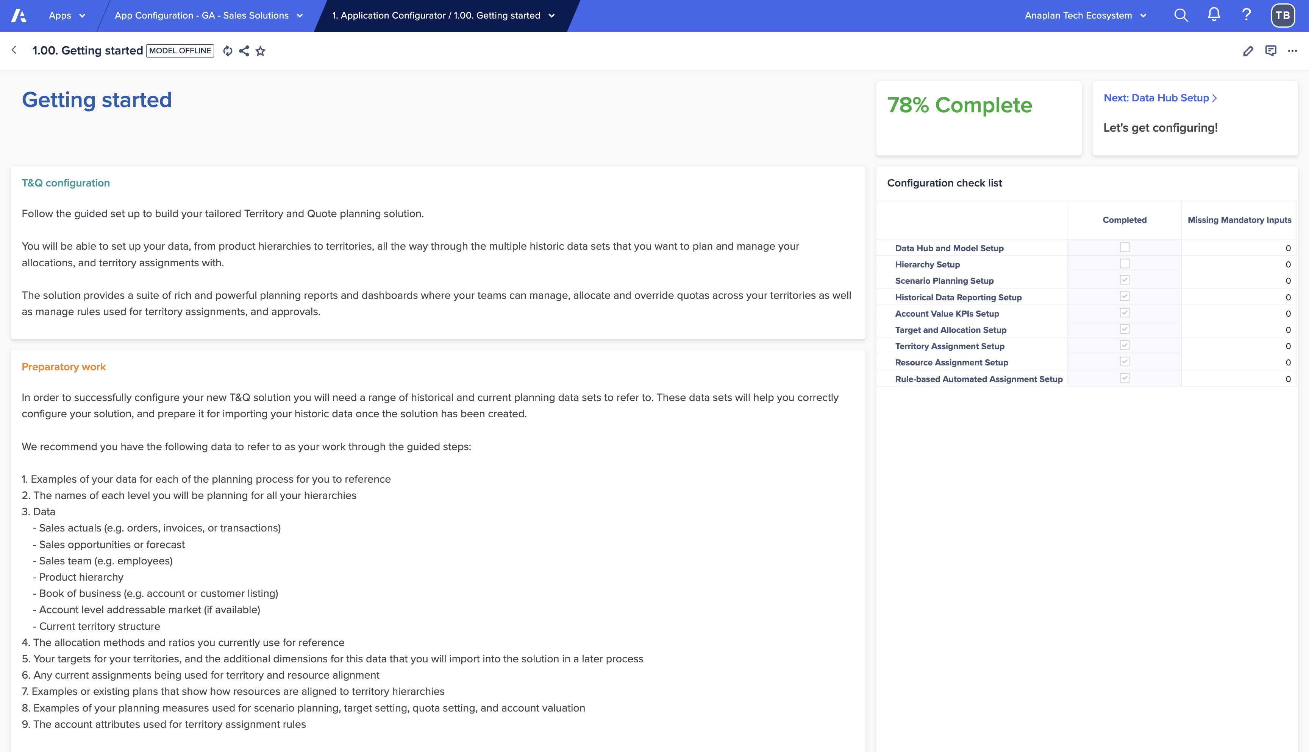
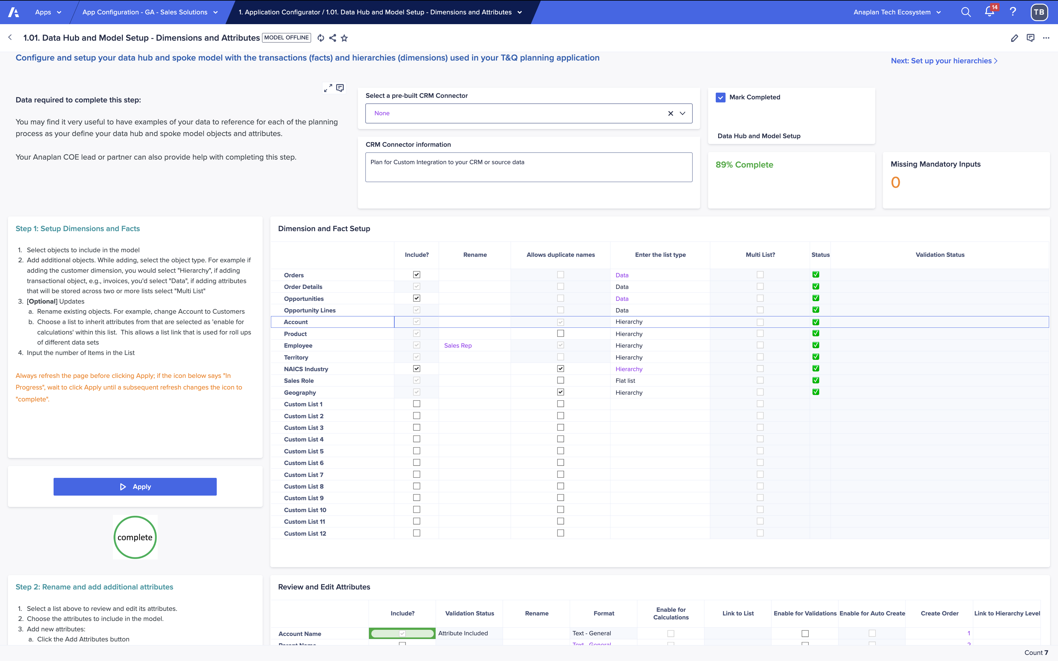
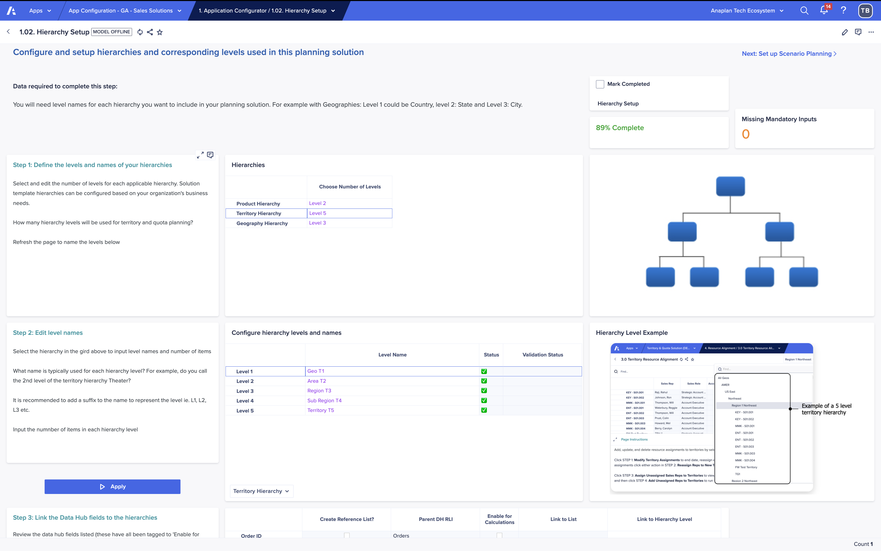
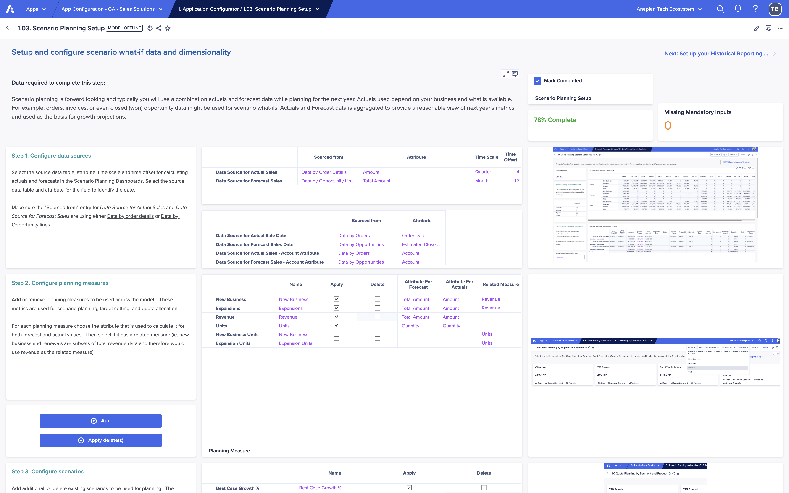
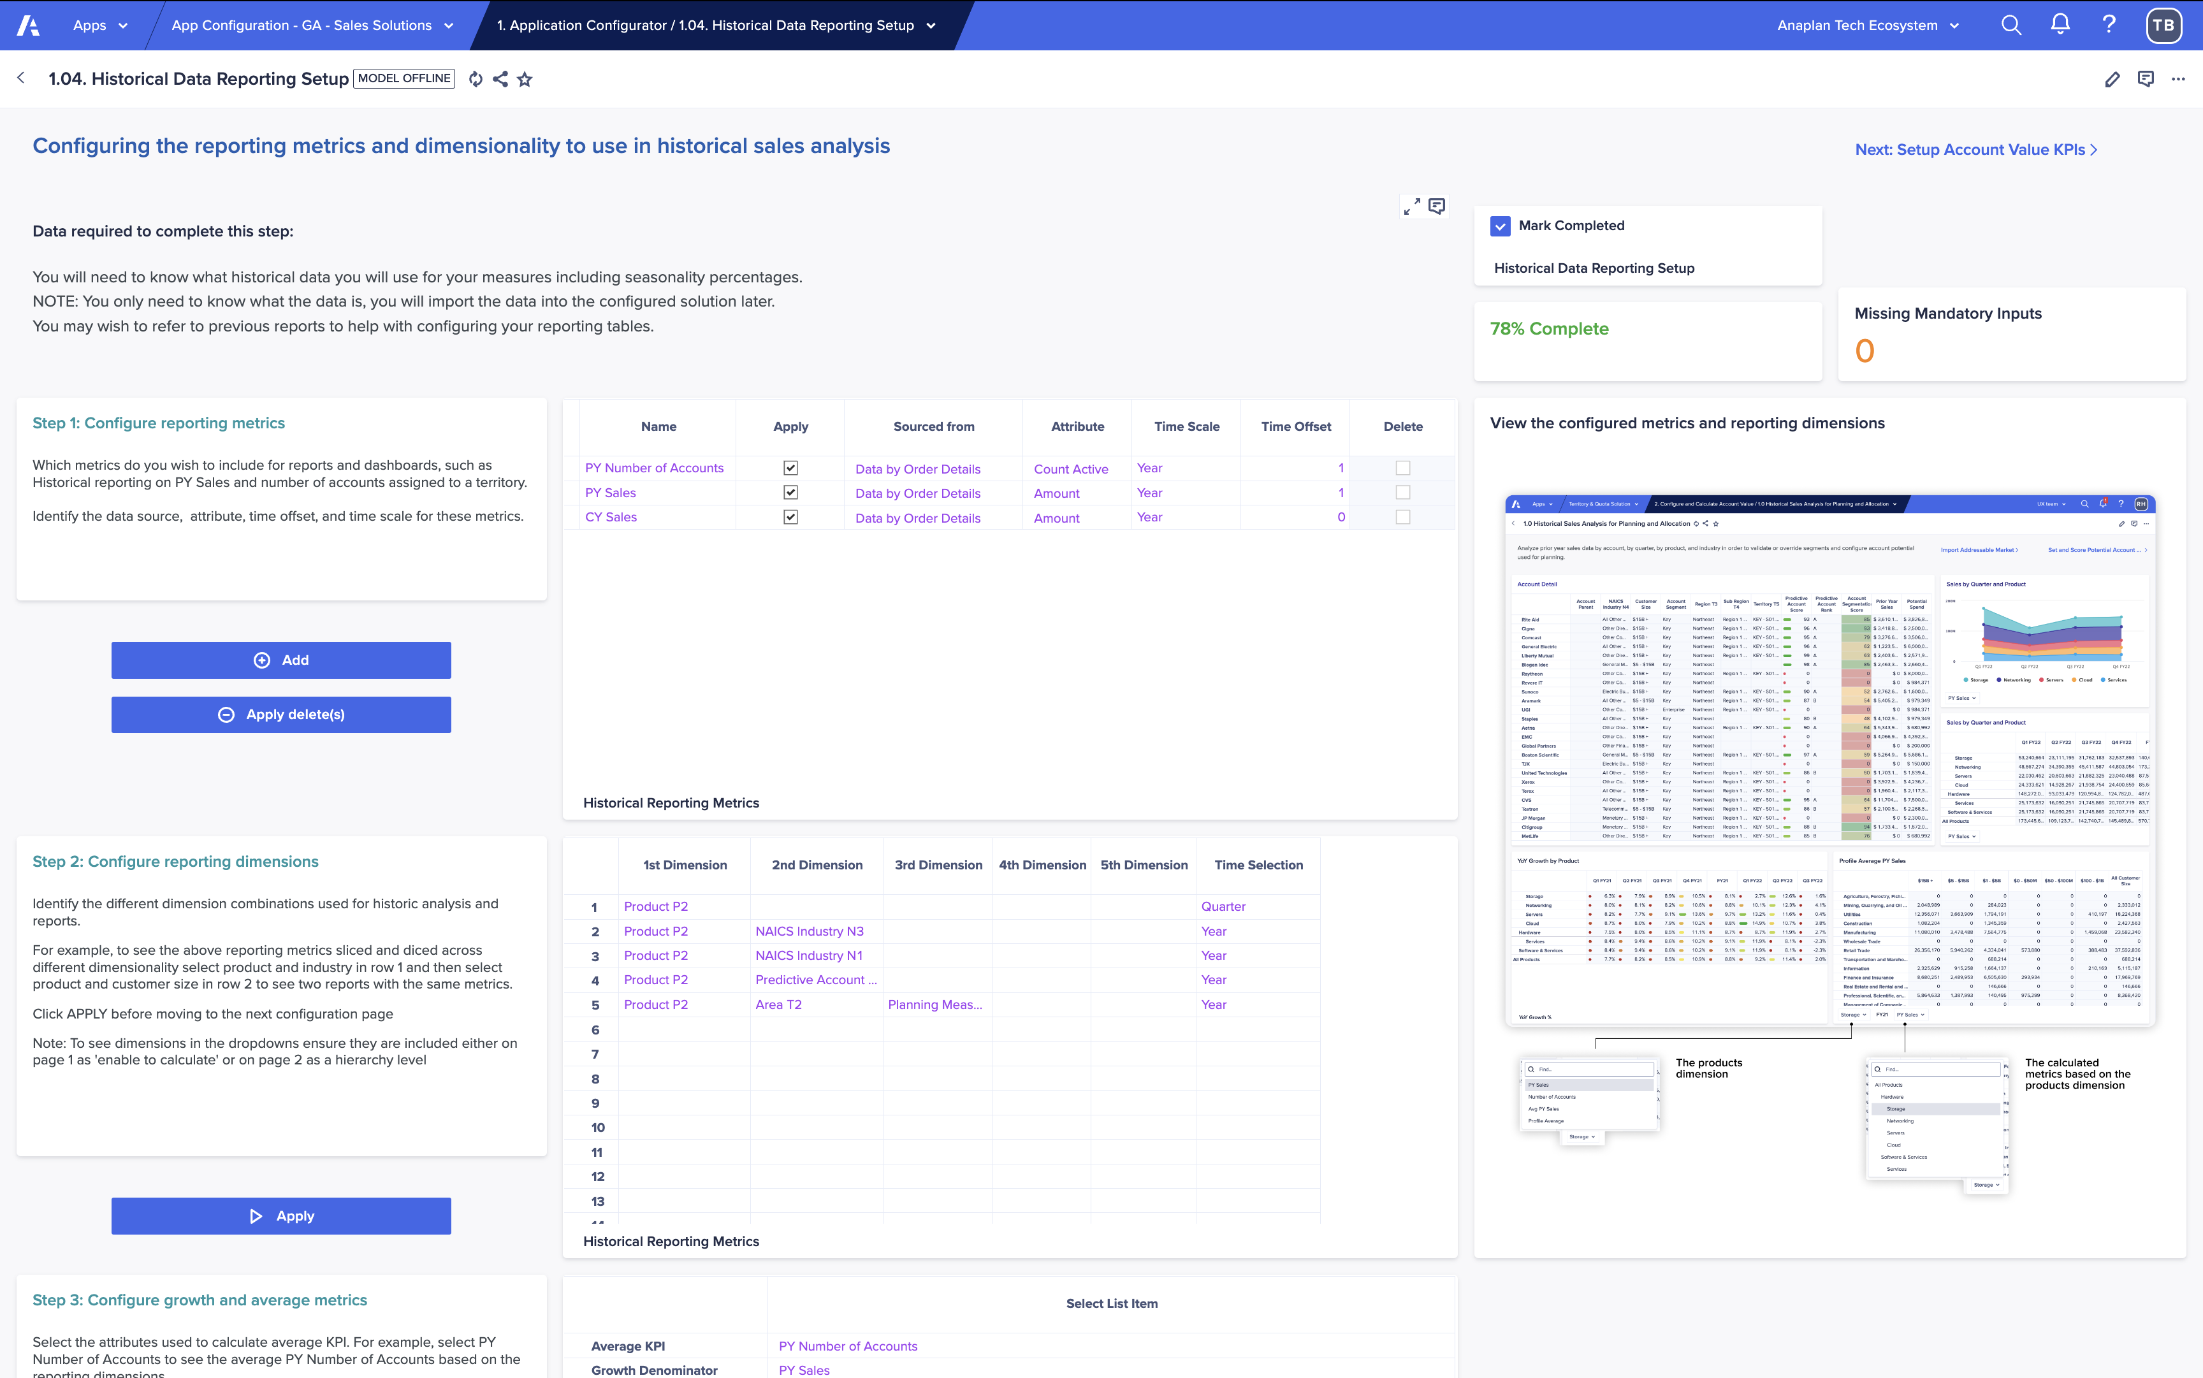
Guided setup powered by the Anaplan Application Framework
Designed to get you to value faster—with a proven, repeatable configuration flow
Guided setup
Quickly configure your application by answering structured questions about your business model, GTM structure, and planning needs—no blank canvas required.
1
2
3
4
Step by Step
Configuration
Deploy…
Data
Hierarchies
Resources
Assignments

Slide 7
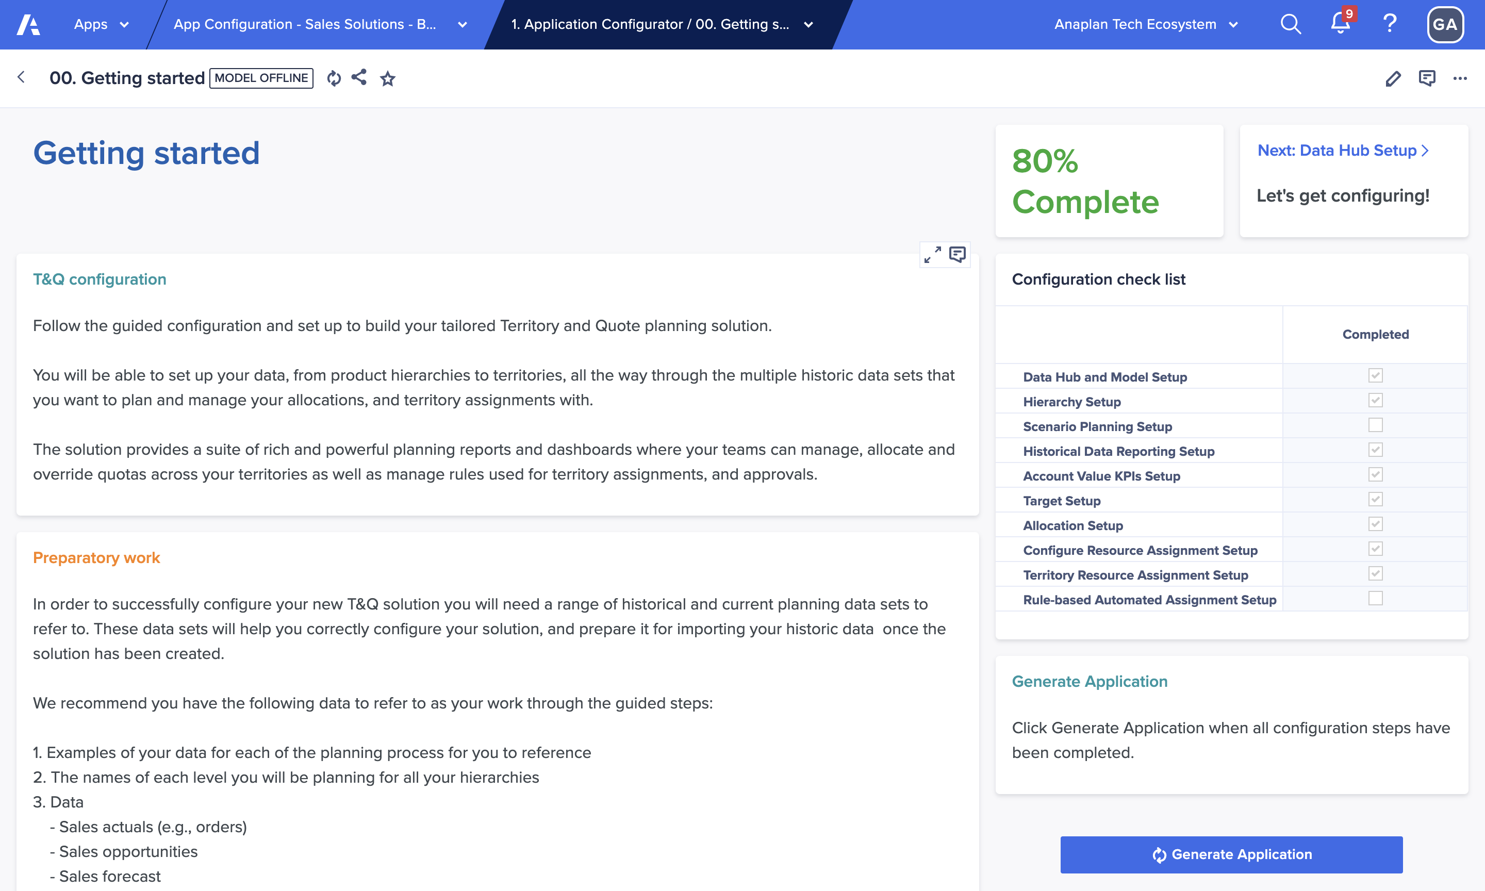
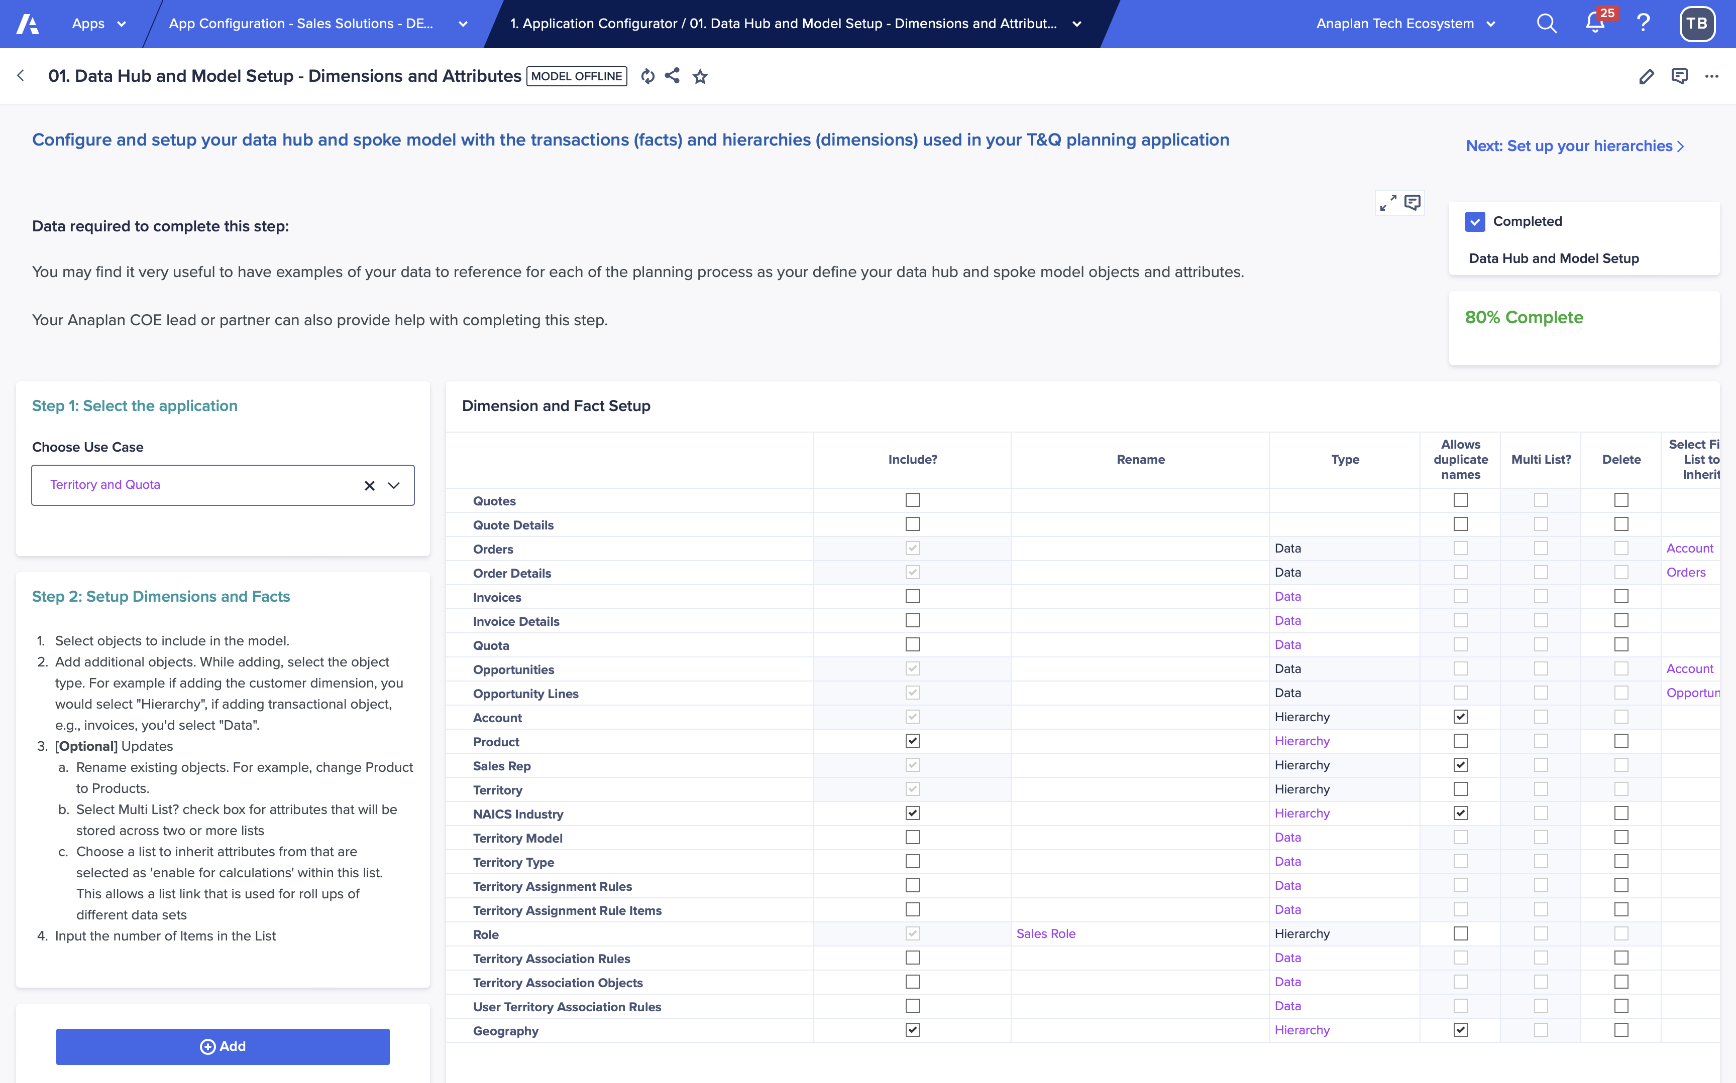
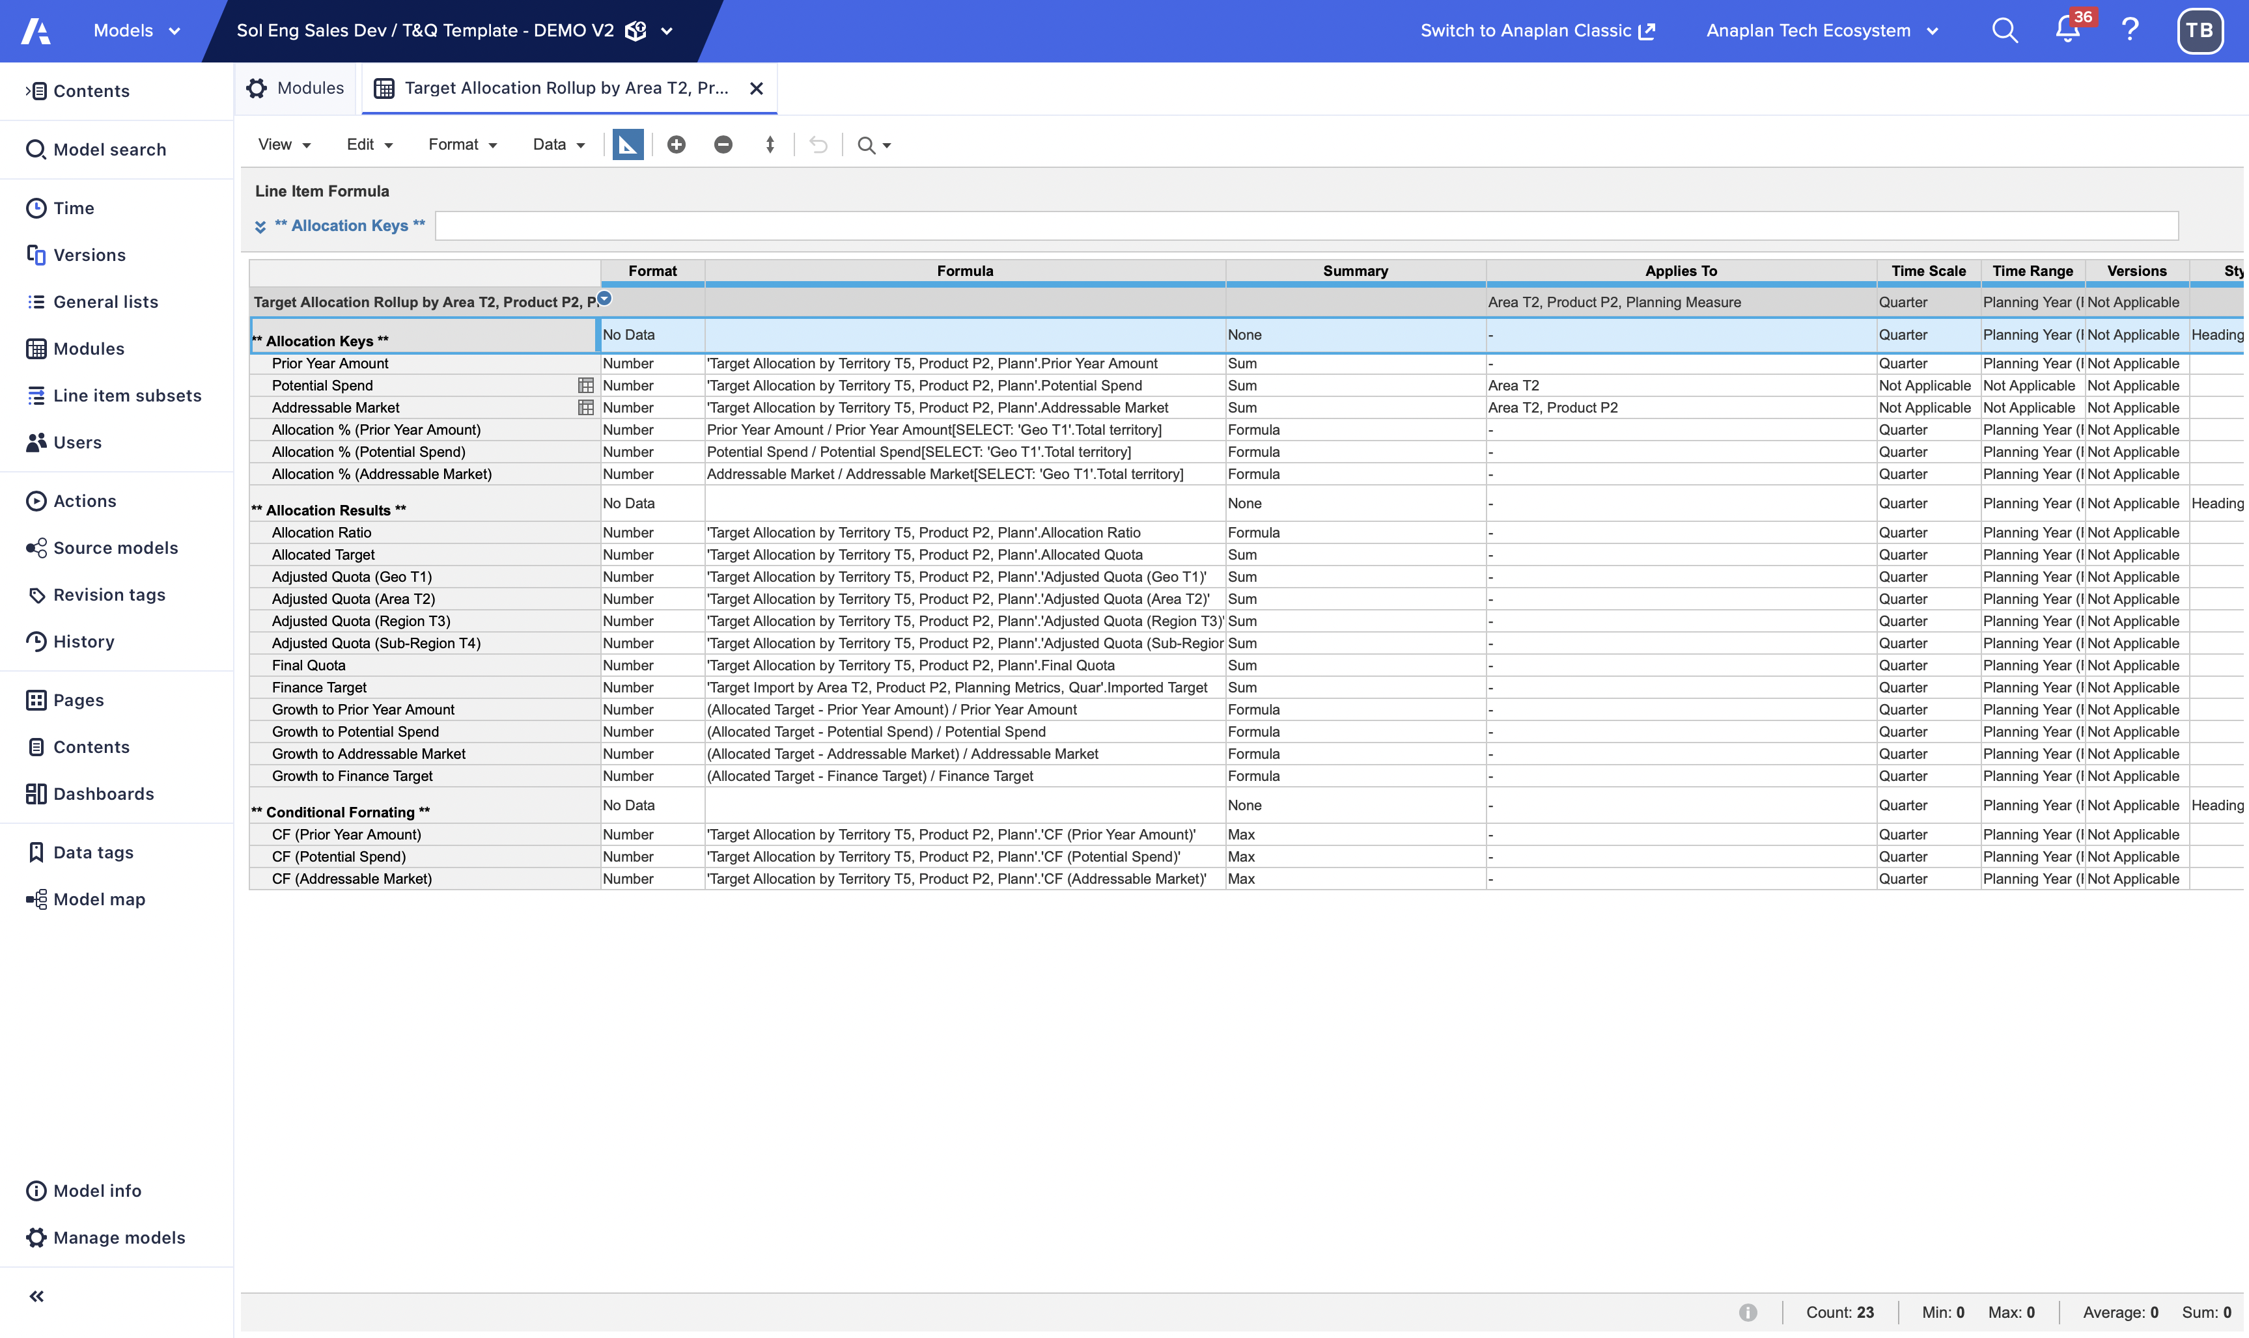
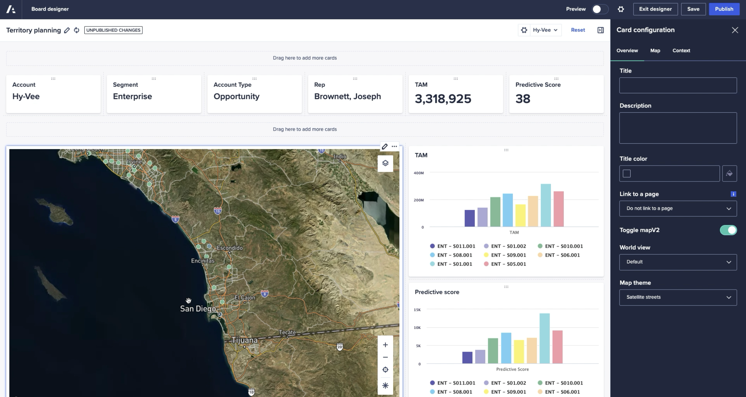
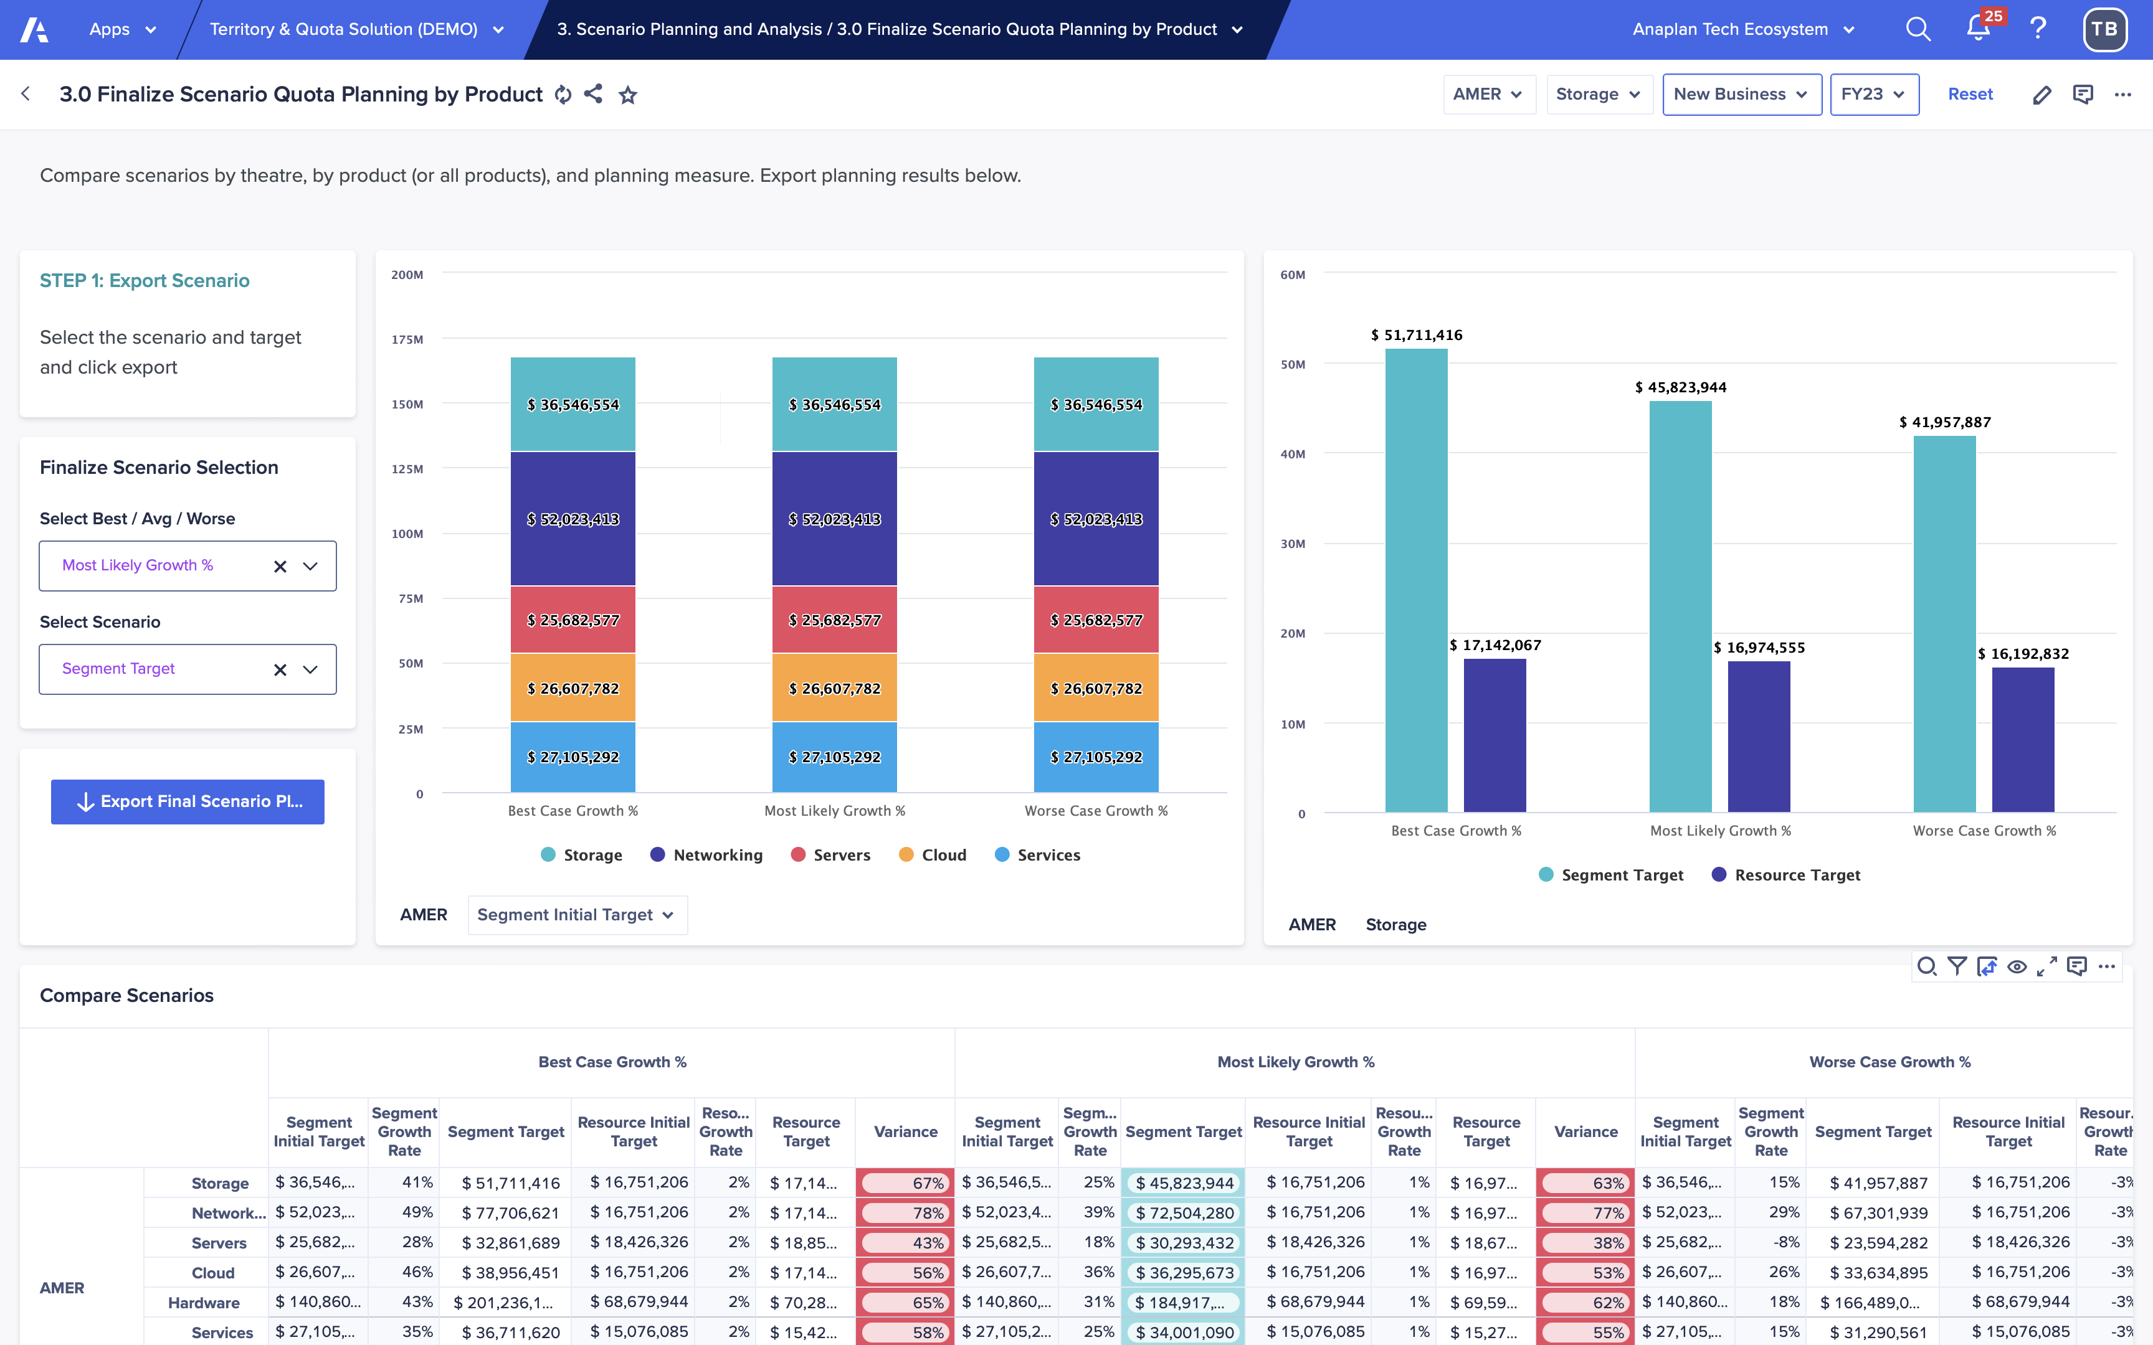
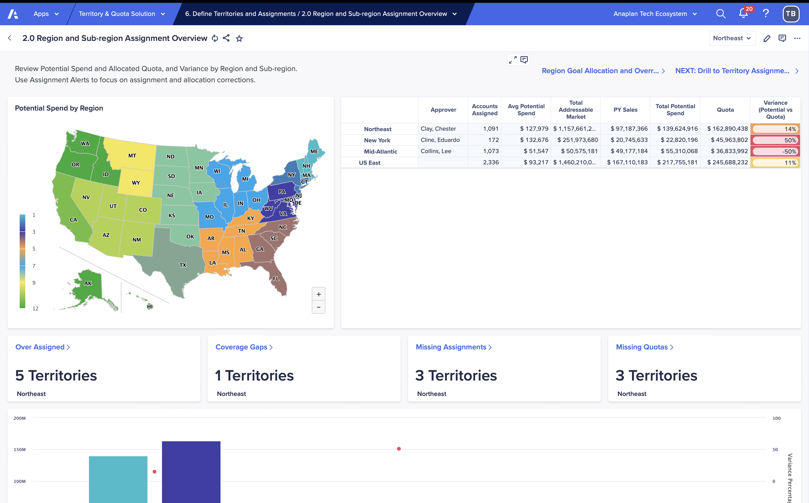
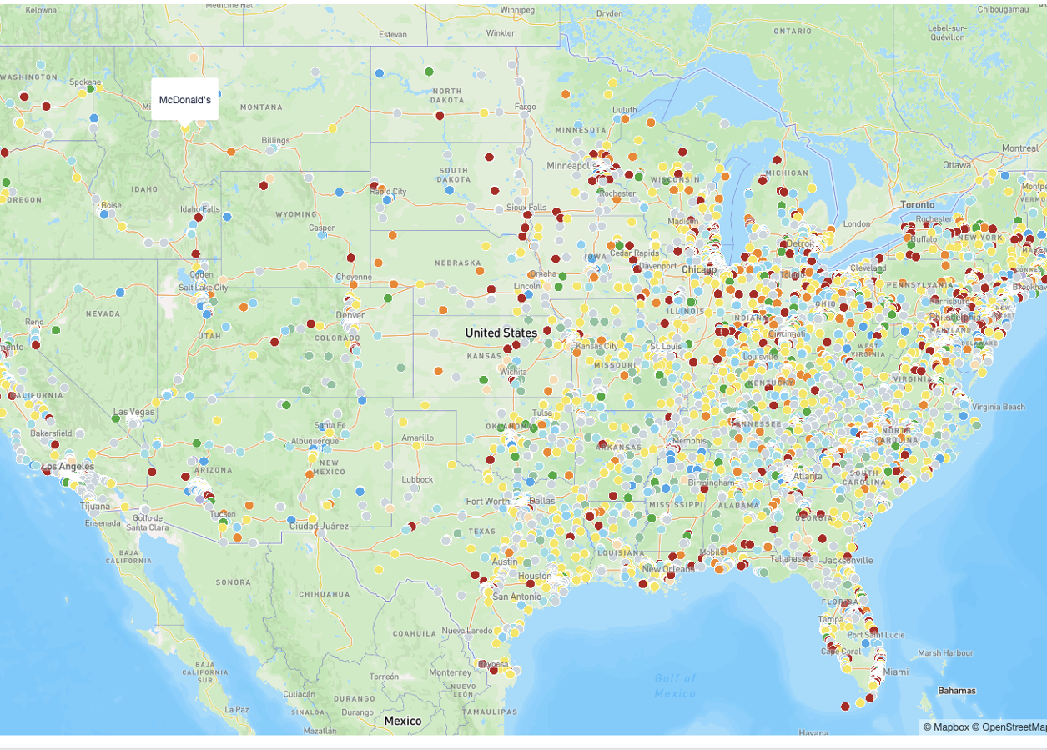
Anaplan Go-to-Market Planning
Application Implementations
3-step implementation: Configure. Extend. Deploy.
Start with a guided setup that builds your model and UX automatically—based on structured inputs about your hierarchies, data, naming conventions, and GTM logic. Your planning foundation is purpose-built from day one.
Configure
Extend
Adapt and expand the application to reflect your business’s unique needs. Leverage the power of Anaplan’s flexible modeling platform to make the
app your own—without starting from scratch.
Deploy
Move quickly into testing and rollout. This accelerated path to deployment helps you capture value sooner, with built-in best practices and a launchpad for future expansion across your business, ready to evolve alongside your business with additional Anaplan applications or purpose-built extensions.

Slide 8
Process and configurable elements
Section 2

Slide 9
Go-to-Market Capacity Planning - Overview
Account Segmentation
Application
Territory & Quota Application
Coverage Analysis
Top-Down Planning
Approved Blueprint
Current FTE Reporting
Average Productivity
Bottom-Up Planning
Sales Margins Planning
In-Year Actual vs Planning
Role Based Performance Review

Slide 10
Go-to-Market Capacity Planning: Key processes and configurable elements
Step | Process name | Process description | Configurability
1 | Current FTE Reporting​ | Real time visibility of HC assigned by various levels of Sales Hierarchy.​ HC & FTE Reporting by Role, Sales Hierarchy and month.​ Ramp Assumption Scenario Modelling.​ Employee level details for role & organization.​ Monthly Role History.​ | Select dimensions to apply for ramping profiles in historical and current positions/employees for FTE calculation.​ Select attributes to analyze historically by employee and position.​ Dimensions here are account-related and are populated automatically.​
2 | Role-Based Performance Review​ | Analyze Performance metrics per Role using configurable dimensions.​ e.g., By Role, Segment, Industry, Tenure Band, etc.​ | Select dimensions to apply for reporting on current role analysis.​ Select sources for Account Data​. Select deals with forecast categories on this list will be included in the Forecast for close won.​
3 | Average Productivity​ | HC Gap Analysis.​ Coverage recommendation for core functions.​ Recommendation of how Resources to allocate should be Split between Core and Support.​ Role/Role & Role/Account Coverage assumption input​. Time Based Coverage assumption (Gartner recommendation for CSM).​ Live Segmentation impact on Capacity gap.​ | Same as above​.
4 | Coverage Analysis​ | Exclude accounts based on pre-defined attributes (e.g., country tier, revenue, employee count).​ Assess the impact of excluded accounts on Wallet Size.​ Prioritize high-potential accounts for planning focus.​ | Select sales hierarchy level to map sales roles to account segments and define role-to-account or role-to-role ratios.​ Select dimensions and sales hierarchy granularity for importing sales targets​. Select the sales hierarchy level to enter workload account and capacity assumptions.​

Slide 11
Go-to-Market Capacity Planning: Key processes and configurable elements – cont.
Step | Process name | Process description | Configurability
5 | Top-Down Planning​ | Input Resources to allocate numbers and cascade down the sales hierarchy.​ What-if Scenario.​ Cascade down constraints & Recommendations.​ Workflow: Approval/Dispute process for Resources to allocate split.​ | Create and name scenarios for tops-down HC target setting and broader application use.​ Select if Role Grade dimension is applicable for your tops-down HC process. Select levels for tops-down HC target setting.​ Select dimensions and sales hierarchy granularity for importing the finance budget​. Select sales hierarchy level to map sales roles to role grades. ​ Select sales hierarchy level to input cost per head assumptions.​
6 | Bottom-up Planning​ | Monthly Hiring & Attrition input per Role.​ Monthly Productivity tracking.​ HC & FTE Reporting by Role and month.​ What-if Scenario.​ TA Collaboration Dashboard.​ | Select the sales hierarchy level for bottoms-up hiring plan review and approvals for both direct and indirect roles.​
7 | Sales Margins Planning​ | Input Role & Level wise average cost.​ Aggregate Cost Data.​ Input/Analyze Cost structure. ​ Monthly Sales Margin tracking (based on Productivity assumption, ramping & seasonality).​ | Select the sales hierarchy level for bottoms-up hiring plan review and approvals for both direct and indirect roles.​ Select dimensions and sales hierarchy granularity for importing the finance budget​.
8​ | In-Year Actual vs Planning​ | Lock Planning Input.​ Approval workflow.​ Snapshot Hiring Plan versions.​ Re-open Planning Period.​ Analyze gap vs plan.​ | Same as Bottom-up Planning.​

Slide 12
Prework and assumptions
Section 3

Slide 13
Assumptions
To successfully implement this application as designed,
the planning process is subject to the following assumptions:
Assumptions
You have an existing, structured territory hierarchy available for alignment and reporting.​
You use position-based planning using data from your HR system or other data sources.​
You leverage either a Sales Role or Job Role structure as part of your hiring plan. ​
Segmentation data is available to inform capacity planning and headcount distribution.
If these are not true today, there are two options:
Modify or extend the application to accommodate the existing planning model.
Adjust the planning process to align with supported methodologies and industry best practices.

Slide 14
Sales data requirements and description
Data | Description | Mandatory attributes​
Actuals (such as orders, bookings, invoices, transactions, etc.) | This can be either one data file, or it can be loaded with two data files where the second is a more detailed line-item level (such as orders and order lines where the order lines contain details by products). | ID, name, account, product, date, amount, last year wallet, ARR. If using the detailed data file, have an ID to link to the initial file. The mandatory attributes must be present between the two data files.
Forecast (such as opportunities, opportunity lines) | This can be either one data file, or it can be loaded with two data files where the second is a more detailed line-item level (such as opportunities and opportunity lines where the lines contain details by products). | ID, name, account, product, date, amount, opportunity owner ID, attribute to filter likely deals (such as forecast category or deal stage) If using the detailed data file, have an ID to link to the initial file. The mandatory attributes must be present between the two data files.
Employee/ Position Data | This data can be loaded in via flat files or from a source system. | ID, Job Family, Role Grade, Sales Role, Sales Hierarchy, Role Start Date, Role End Date, SFDC ID.
CSV files should be a flat view with the attribute fields in columns and items in rows.
The files can include additional attribute fields.
Additional data files can be brought in as needed.
All files should have a column for "Date Loaded to Anaplan" that should be populated with the current date.

Slide 15
Metadata requirements and description
Dimensions | Description | Mandatory attributes
Accounts (could also be clients, customers, etc.) | Source data for any down-stream account summary reporting. | Name, ID, Parent, Territory, Address (city, state, country, postal code), account owner
Opportunity | Source data before down-stream opportunity summary reporting. | Name, ID, Account, Product ID, Estimated Close Date, Total Amount, Stage, Stage Entry Date
Employee (could also be sales reps, sellers, etc.) | Used to map employees to source data like opportunity data, Account, Position. | ID, Role Start and End date, Hire date, Sales Role, Role Grade, Job Family, sales hierarchy
Position​ | Used for Current role-based metrics like headcount, FTE, and average productivity . ​ | Position ID, Employee ID, Sales hierarchy, Job family, Sales role, Role grade, Role end and Start date​
Job Family ​ | Used for any relevant reporting and planning, Yearly performance and the top-down process​ | Name, ID, Parent, Sales role mapping
Sales Role​ | Used for any relevant reporting and planning like Yearly performance, the top-down process, the bottom-up hiring plan, and mapping to segmentation data​. | Name, ID, Job family mapping, Direct sellers roles​
Role Grade​ (optional) | Used for any relevant reporting and planning, Yearly performance, and the top-down process​. | Name, ID
CSV files should be a flat view with the attribute fields in columns and dimension items in rows.
The files can include additional attribute fields.
Additional dimensions and hierarchies can be brought in as needed.
Where numbered lists are referenced (for example, DH Attributes by Account Flat. Account Parent), the value loaded to that field in the data hub should be the CODE, not the name (e.g., 1234 rather than Procter and Gamble).
For files that contain hierarchies, they must be in parent child format. There's no need to include a parent for the first level of the hierarchy.

Slide 16
Model design
Section 4

Slide 17
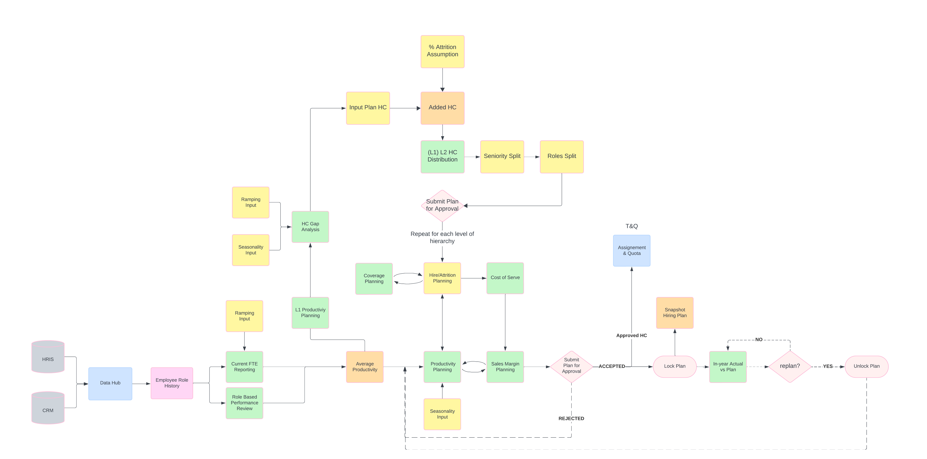
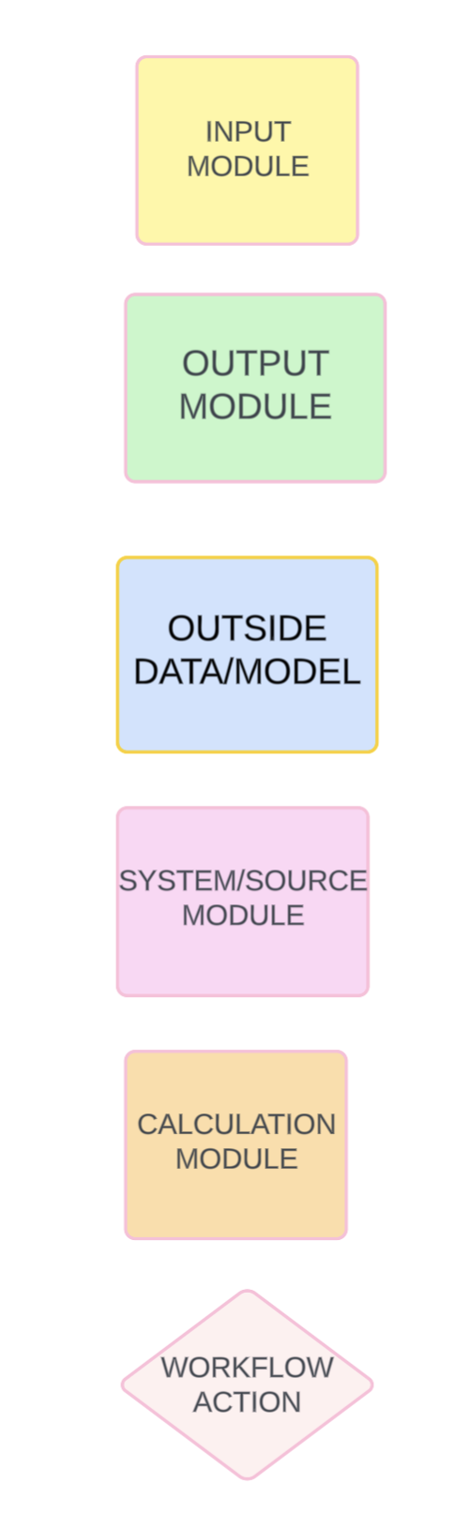
Model diagram overview
Module Legend

Slide 18
Define headcount data:
key modules
Generic module name | Description | Guided setup inputs / explanation
OUT: Yearly Performance​ | Provides reporting on historical data to include things like Current HC & FTEs, # of Won Deals, Closed Won ACV, # of Accounts, Average Productivity ​ | Module will get replicated by selected attributes by both the sales role dimension as well as the bottom level of the job family.
OUT: FTE​ | Output module to show both headcount and FTE counts by month ​ | Module will get replicated by selected attributes by both the sales role dimension as well as the bottom level of the job family.​
CALC: Position by Month​ ​ | Calculation module to help calculate headcount and FTE over time, with taking into account ramping profiles and start/end dates for positions​ | ​ ​
INP: Historical Ramping Profile Assumptions​ ​ | Input module for monthly ramping profiles by selected dimensions in the configurator and historical years to be used in calculating FTEs over time​ | Dimensionality can be configured​.

Slide 19
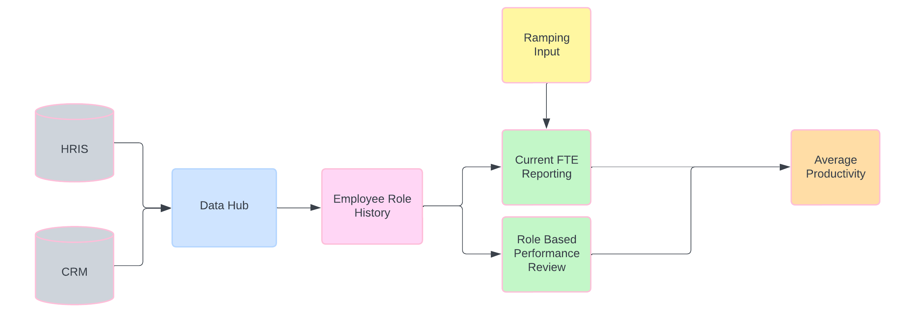
Headcount data:
diagram

Slide 20
Define Headcount Gap Analysis: key modules
Generic module name | Description | Guided setup inputs / explanation
OUT: HC Gap Direct Sellers Target Capacity​ | An output module to view monthly productivity vs target Gap that is based on current headcount, added headcount hiring plan, bookings target, and productivity assumptions. | ​
INP: HC Gap Area Role Scenario Assumptions​ | Input module to put in productivity assumptions such as attainment % and productivity growth % which drive expected productivity​. | ​
INP: Monthly Seasonality​ ​ | Input module to breakdown yearly productivity and target values down to the month​. | ​
INP: HC Gap Sales Role Coverage by Geo​ | Module that shows coverage types and desired ratios by sales role as well as Planned HC based on coverage assumptions and used in Suggested Revenue HC in the top-down planning process​. | ​

Slide 21
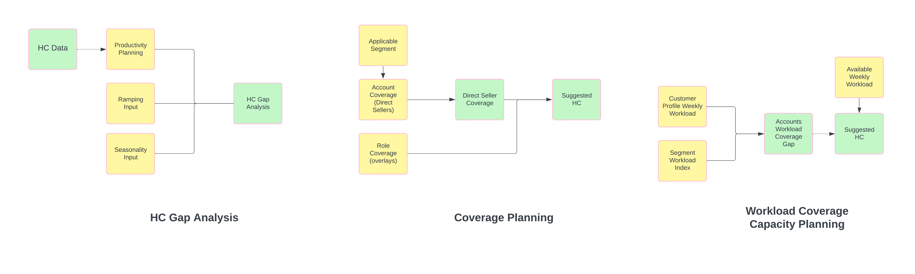
Headcount Gap Analysis:
diagram

Slide 22
Define Coverage Planning: key modules
Generic module name | Description | Guided setup inputs / explanation
OUT: YoY Segment Metrics​ | Shows account data aggregated to sales hierarchy and segment. Metrics like current # of accounts, inflow/outlfow, target, and wallet size.​ | ​
INP: Segment to Role Mapping​ | Used to select which sales roles apply to which segments. | You can select which level of the sales hierarchy this can be at within the configurator​
INP: Coverage by Sales Role Flat​ | Used to look at current HC and account data by sales role, s well as select coverage type, role constraint, and desired ratios to give you suggested headcount based on coverage data​. | You can select which level of the sales hierarchy this can be at within the configurator​ ​
INP: Sales Role Coverage​ | Used to calculate suggested headcount at lower levels of the sales hierarchy based on coverage and desired ratio inputs above.​ | ​

Slide 23
Coverage Planning :
diagram

Slide 24
Define Workload Coverage Capacity Planning: key modules
Generic module name | Description | Guided setup inputs / explanation
OUT: Coverage Headcount​ | This module shows aggregated data based on inputs and calculation modules within the workload capacity process and shows Suggested Workload Headcount​ | You can select which level of the sales hierarchy this can be at within the configurator​.
INP: Coverage Utilization Assumptions​ | Input available hours per week by roles applicable for workload calculations ​ | You can select which level of the sales hierarchy this can be at within the configurator​.
INP: Workload Coverage Filter by Job Family L2​ | Select which job families should be shown and used within the workload coverage capacity exercise ​ | You can select which level of the sales hierarchy this can be at within the configurator​.
INP: Workload Coverage Time Inputs​ | Input hours needed per account per week by sales role, customer profile, and segment​ | You can select which level of the sales hierarchy this can be at within the configurator​.
INP: Coverage Segment Factor​ | Select multiplier used to multiply workload hours needed segment​ | You can select which level of the sales hierarchy this can be at within the configurator​.
OUT: Coverage Account Hours​ | Used to calculate Hours needed per week by role, based on assumption modules above​ | ​
CALC: Coverage Headcount​ | Used to calculate total hours needed by segment and hours needed gap to help calculate suggested headcount based on workload​ | ​

Slide 25
Workload Coverage Capacity Planning:
diagram

Slide 26
Define Top-Down Headcount Target Setting: key modules
Generic module name | Description | Guided setup inputs / explanation
OUT: Global NTE Target​ | Input global planned headcount and attrition assumptions that will cascade the headcount target down the hc planning process​. | ​
INP: Tops Down HC Planning​ | Module to view Current and suggested HC, and then input +/- HC for planning year by Job Family Group L1​. | Applicable Levels of the sales hierarchy.
OUT: Tops Down HC Metrics by Geo T1​ | Standard metrics to view that will aid in allocating your planned headcount in the tops down process.​ | ​
INP: Tops Down HC by ​ | Module to view Current and suggested HC, and then allocate HC for planning year by Job Family Group L1 & Role Grade, or by Job family L2.​ | ​
INP: Tops Down Workflow ​ | Module used for the workflow to select a final scenario and submit that scenario to the next level down. ​ | ​
INP: Job Family Role Grade HC​ | Module used for the last level of planning for a job family where we allocate the planned headcount by the job family L2 and the Role Grade.​ | An end user can configure which level of the sales hierarchy each job family ends at​.
INP: Job Title to Role Grade Hiring​ | The last step for each level of the tops down process for the job family L2's that end at that level. This is where you allocate the planned headcount down to the Sales Role and Role Grade​. | An end user can filter which role grades apply to which sales role​.

Slide 27
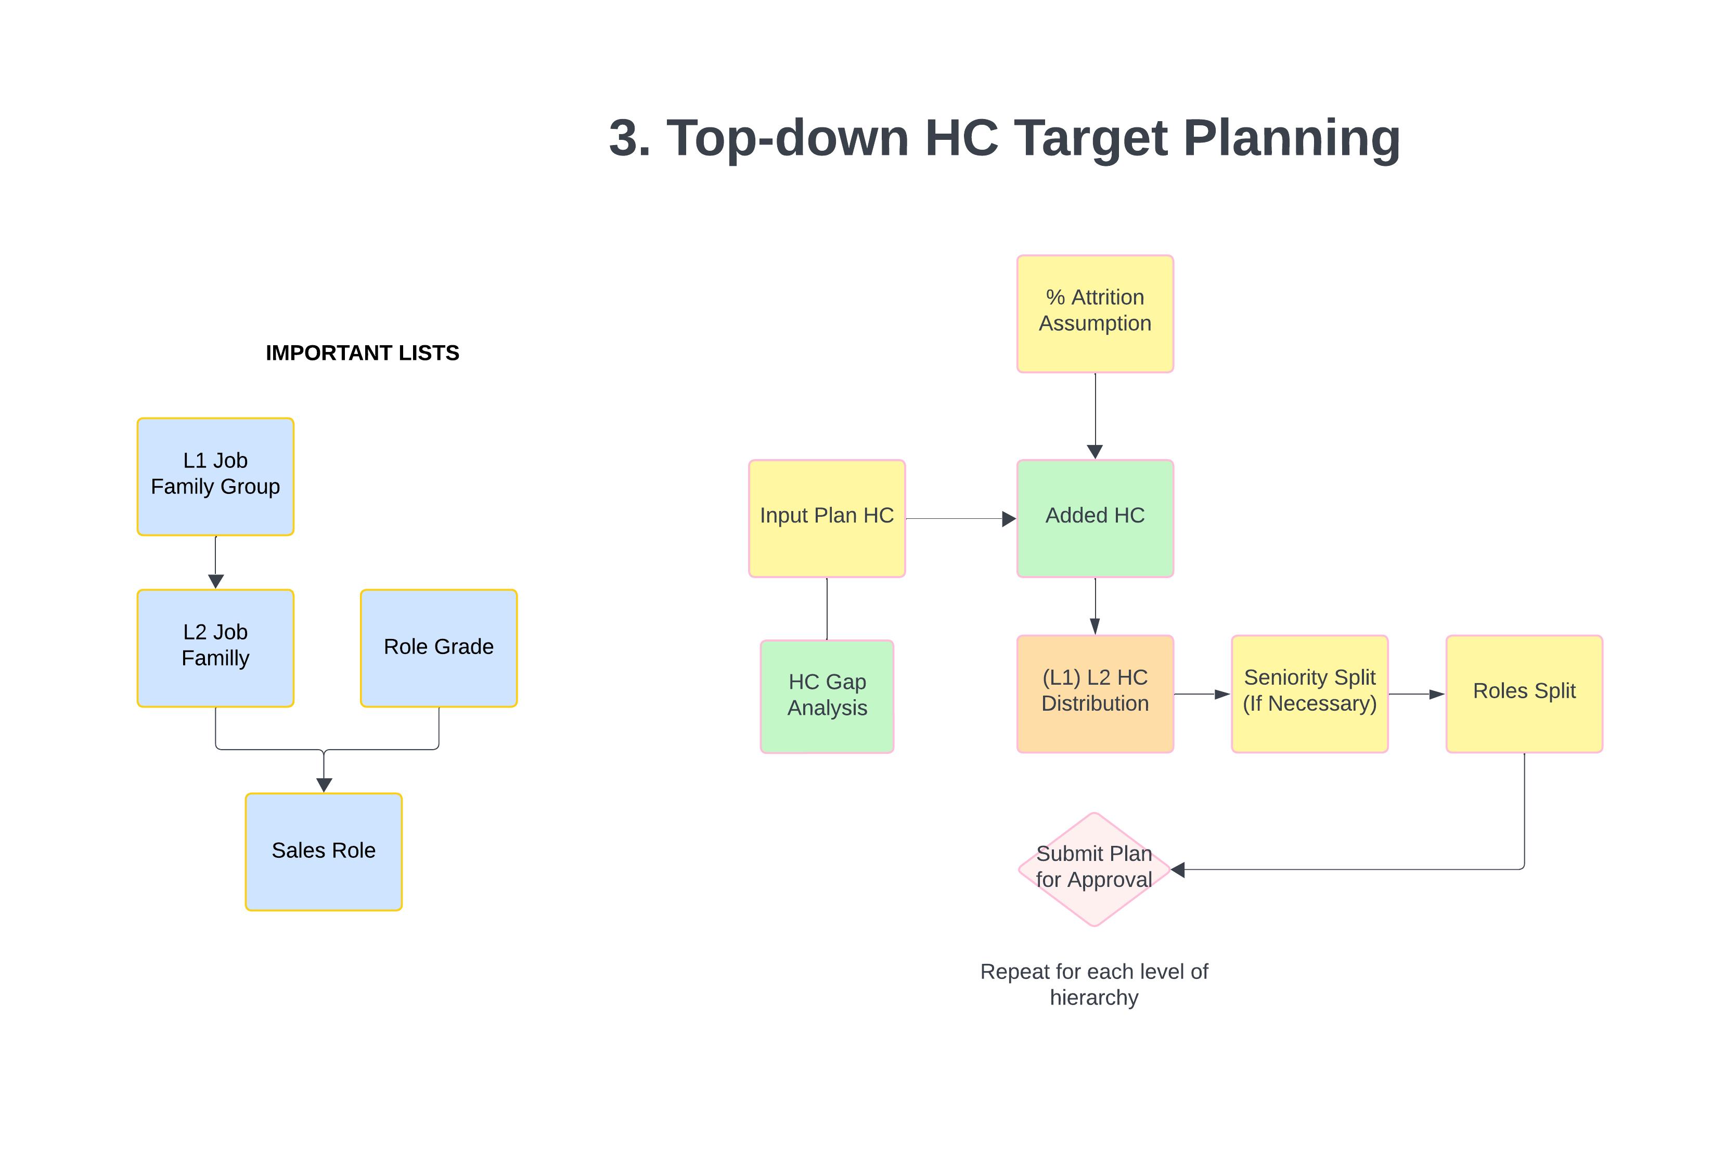
Top-Down Headcount Target Setting:
diagram

Slide 28
Define Bottom-Up Hiring Plan: key modules
Generic module name | Description | Guided setup inputs / explanation
OUT: Direct Sellers Target Capacity Scenarios​ | Very important reporting module that takes current Direct sales role FTE and productivity and shows added fte and productivity, and compares that against the bookings target for the planning year​ | Granularity of sales hierarchy is based on bottom level of planning​
INP: New Hires​ | Input module where a user inputs new hires and attrition by month, direct sales role, and at the lowest level of the sales hierarchy for the planning year that then feeds all the calcs in the above module​ | ​
INP: Role Scenario Assumptions​ | Inputs assumptions that are driving the current and added productivity for the planning year...assumptions like ramping profile, planned producitivity, and planned costs​ | Level of the sales hierarchy this is at matches the approval level set for the bottom-up process​
INP: Workflow Plan Approval​ | Shows the workflow status for each level of the sales hierarchy and if the data is locked or unlocked in the bottom-up process, also submit and approve based on workflow​ | Level of sales hierarchy to do approvals at​
INP: Non-Direct Hiring Plan_T​ | This module is recreated at each level of the sales hierarchy and the applicable sales role for each level depends on what level of the sales hierarchy was the last level of planning for the job family (see top-down process for that). Much like the top module, used for reporting and inputting new HC by month and applicable sales role ​ | ​
OUT: New Hire Properties ​ | This module shows the submitted and approved reqs that are created based on the bottom-up hiring plan. This data can be pushed to downstream source systems and models.​ | ​
OUT: Direct Sellers Target Capacity Final​ | This is a reporting module much like the top one but only shows data that been submitted and approved​ | ​

Slide 29
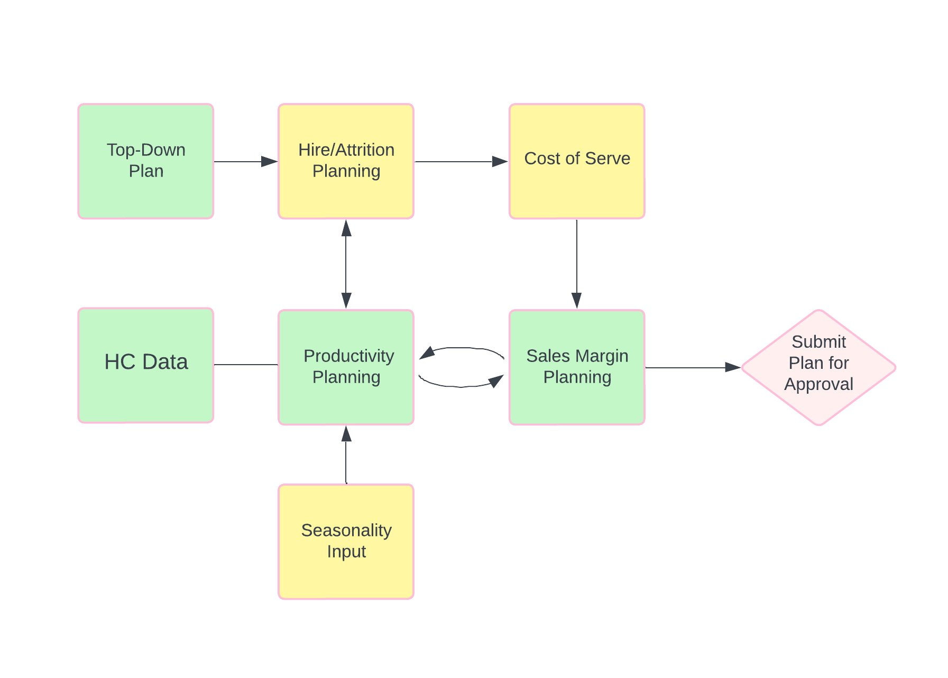
Bottom-up Hiring Plan:
diagram

Slide 30
Define Approval, Snapshotting, and In-Year Planning​: key modules
Generic module name | Description | Guided setup inputs / explanation
INP: Workflow Plan Approval​ | Shows the workflow status for each level of the sales hierarchy and if the data is locked or unlocked in the bottom-up process, also submit and approve based on workflow​ | Level of sales hierarchy to do approvals at​
OUT: Direct Sellers Target Capacity Scenarios​ | Very important reporting module that takes current Direct sales role FTE and productivity and shows added fte and productivity, and compares that against the bookings target for the planning year, as well as locks data and shows actuals when in in-year planning​ | Granularity of sales hierarchy is based on bottom level of planning​
INP: Flat Hierarchy Snapshot by Region T3​ | When a snapshot is run, it snapshots the lowest level of the sales hierarchy nodes. This module is a way to map new sales regions to old sales regions so that history is correct when new sales regions are added/changed during the sales planning process​ | ​
SNAPSHOT: Direct Sellers Target Capacity​ | This module is where the all the snapshotted metrics are imported into by forecast version to compare against the current plan on hiring plan pages.​ | ​
INPUT: Forecast Version Name​ | This module is where you name the snapshot and select if it's your AOP prior to running snapshot action​ | ​

Slide 31
OWP to GTM Capacity Planning Integration
Bring in metrics from our OWP application for the following metrics to help you with the Bottoms-Up planning process in Capacity Planning
Data from OWP to Capacity Planning that you will need to import
Attrition Rate % by Month, Job Family, Role Grade, Sales Hierarchy
Time to Hire by Sales Role
Modules to Import Data into
IMP: OWP Attrition Metrics
IMP: OWP Time to Hire
Page to See Data
OWP Direct Seller Hiring Plan
Right now, Manual imports are needed to get the relevant OWP data into the import modules. This will need to be done during the implementation

Slide 32
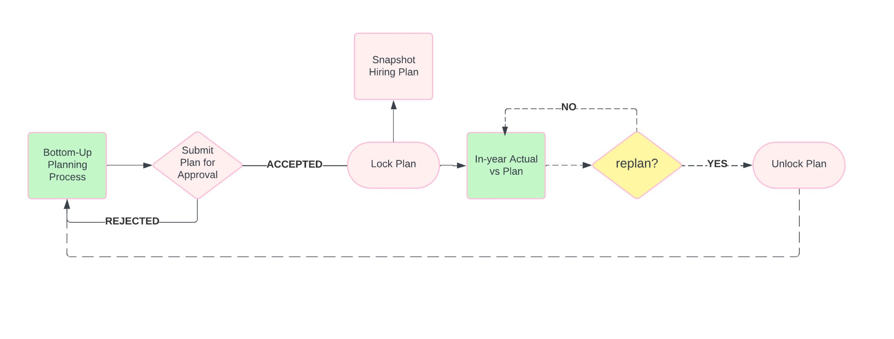
Approval, Snapshotting, and In-Year Planning​:
diagram

Slide 33
For more information, refer to applications.anaplan.com

